Slide 1


Handling Imbalanced Data to Predict Credit Card Fraud
By Christina Vosnak
Notes:
Hello and welcome to this presentation which will dive into a credit card fraud transaction dataset to see if predictive models can accurately predict fraudulent transactions to mitigate credit card transaction risks for both businesses and consumers.

Slide 2
Business Problem
Credit card fraud impacts both institutions and consumers
Billions of dollars are lost each year due to fraudulent transactions
Consumers become hesitant to open and maintain accounts when the risk of fraud exists
Notes:
Credit card fraud is a major threat worldwide that impacts both institutions and consumers. Each year, billions of dollars are lost in fraudulent transactions which affect businesses’ profitability and the risk of consumer accounts. This project aims to develop a predictive model capable of identifying fraudulent transactions with high precision and recall, while minimizing the inconvenience of false positives.

Slide 3

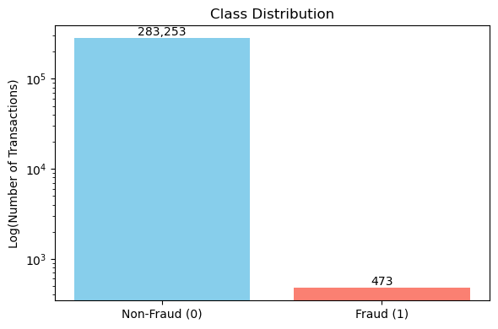
Data Collection
Credit Card Transaction Dataset
European Cardholders over a two-day period
284,807 transactions (only 492 marked as fraud)
Highly imbalanced
Notes:
The dataset used for this project was sourced from Kaggle and contains credit card transactions made by European cardholders over a two-day period. It contains 284,807 transactions, with 492 labeled as fraudulent (a highly imbalanced dataset). It is important to note that the numerical features are a results of a Principal Component Analysis transformation, except for 'Time' and 'Amount’… which is great inconsideration of ethics and anonymity but makes it impossible to trace back which exact features may contribute to fraudulent transaction detection.

Slide 4
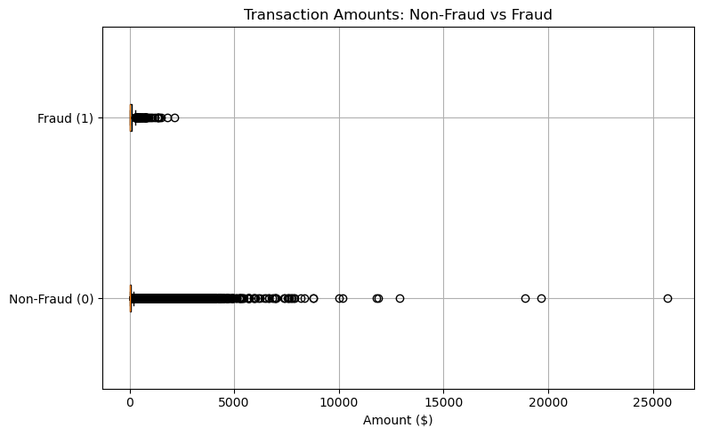
Transaction Amounts – Fraud vs. Non-Fraud
Notes:
Before diving into model building, I conducted an exploratory data analysis of the information to understand if any trends exist in the dataset. To begin, I created box showing the distribution of the transaction amounts within fraud and non-fraud transactions. And right away, we can see that fraudulent transactions only amount up to about $3,000 compared to non-fraud transactions which can range up to almost 10,000 with a few outliers present.

Slide 5
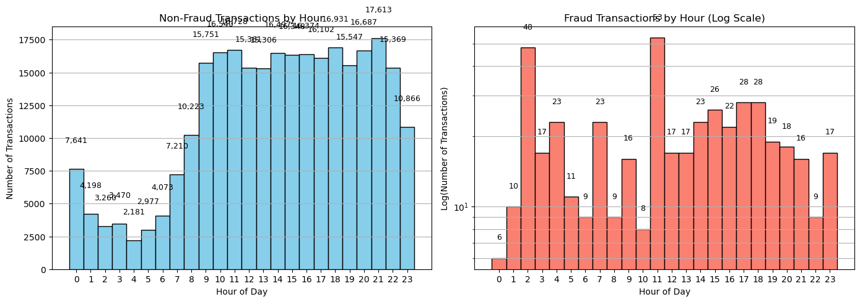
Transactions over Time – Fraud vs. Non-Fraud
Notes:
Additionally, I looked at transactions over time, through a histogram and found that non-fraud transactions follow a typical pattern of the average consumer where transactions are high during business and early evening hours and lower during throughout the late evening when most individuals sleep and business are closed. The fraudulent transactions however peak at 2AM and 11AM which is important to consider when looking at the data in the future.

Slide 6
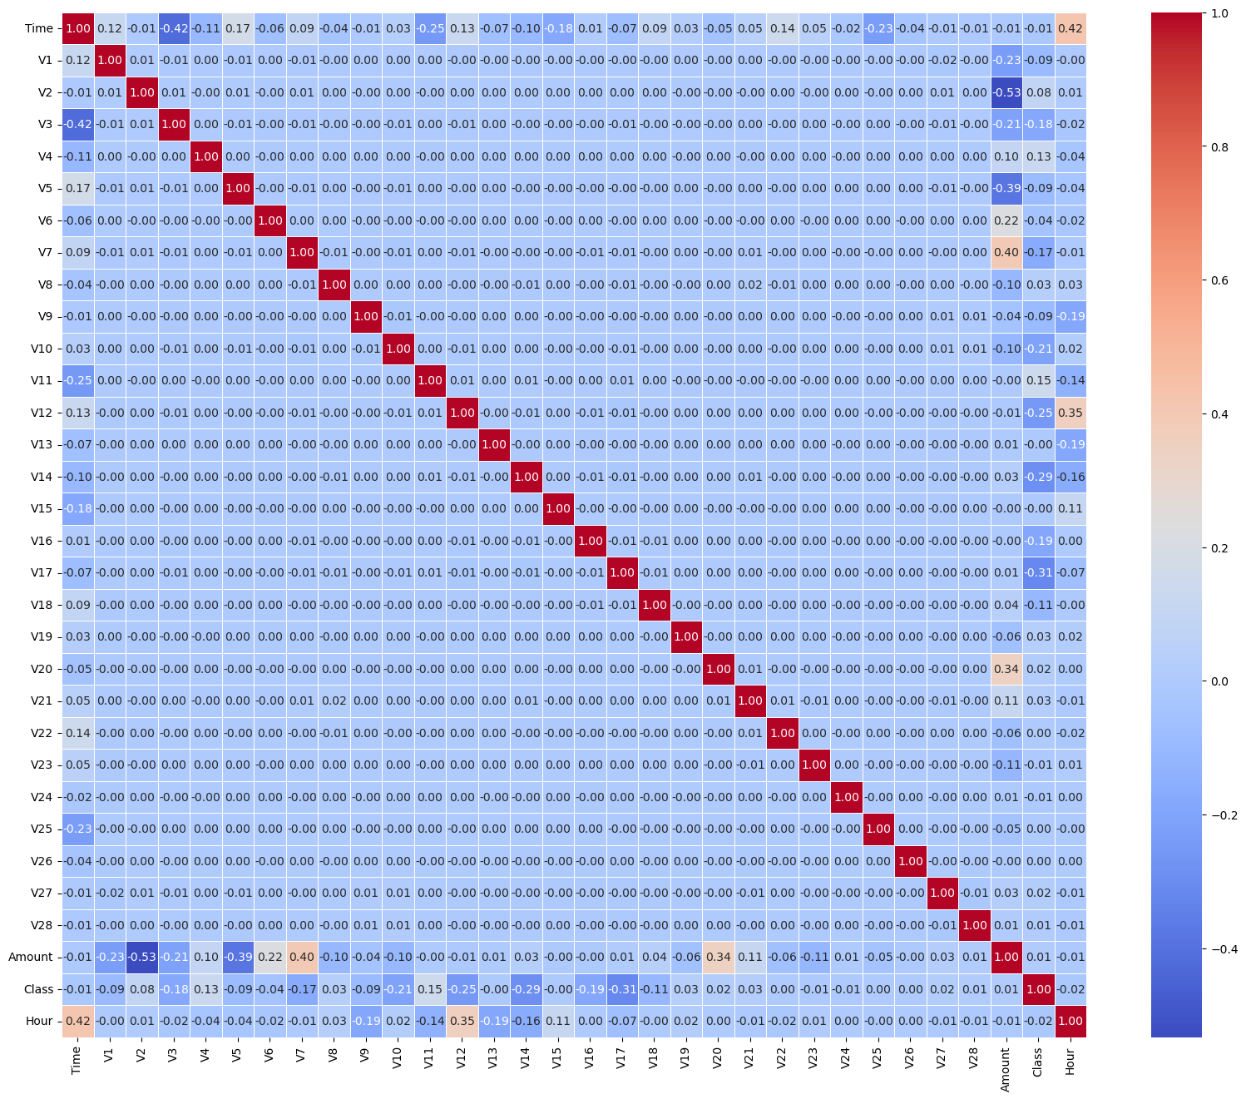
Correlation Heatmap
Notes:
Finally, I created a correlation heatmap to identify if any linear trends exist between the variables, and while some trends do exist, nothing is significant in terms of directly tying to fraud detection.

Slide 7
Handling Class Imbalance
SMOTE – to oversample minority class (fraudulent transactions)
Balances the dataset without losing valuable information
Notes:
In any credit card transaction dataset, you are going to find a significant imbalance within the dataset. For this project, I’ve decided to use SMOTE to oversample the minority class which in this case is fraudulent transactions as it will balance the dataset without losing valuable information

Slide 8
Methods
Logistic Regression
Random Forest Classifier
XGBoost
Notes:
After balancing the dataset, I will be training and testing 3 predictive models, a logistic regression as a baseline due to its simplicity and interpretability, a random forest classifiey as a powerful model to handle imbalanced data and feature importance insights, and XGBoost which is a high-performance gradient boosting algorithm know for its accuracy and ability to handle complex relationships with data

Slide 9
Evaluation Metrics
Precision
Recall
F1-Score
AUC-ROC
Notes:
I also selected 4 evaluation metrics to evaluate the results of each model to hopefully identify a best fit for the data. I chose precision to measure how many predicted fraud cases were actually correct while using recall to show how many real frauds were successfully detects. The F1-score balances both precision and recall giving a more holistic view of performance. Finally, AUC-ROC measures how well the model distinguishes between fraudulent and non-fraudulent transactions across different thresholds.

Slide 10
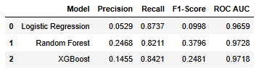
Results
Random Forest Classifier and XGBoost performed best
Notes:
We can see the results of the models and their performance through the chart on this slide While Logistic Regression achieved the highest recall (0.8737), it had extremely low precision (0.0529), leading to a poor F1-Score. In contrast, both Random Forest and XGBoost provided a much better balance, with significantly higher precision and F1-Scores. Random Forest achieved the highest F1-Score (0.3796) and ROC AUC (0.9728), indicating it was the most effective overall. XGBoost also performed well, especially in recall and AUC, showing it was nearly as strong while maintaining slightly better precision than Logistic Regression.

Slide 11
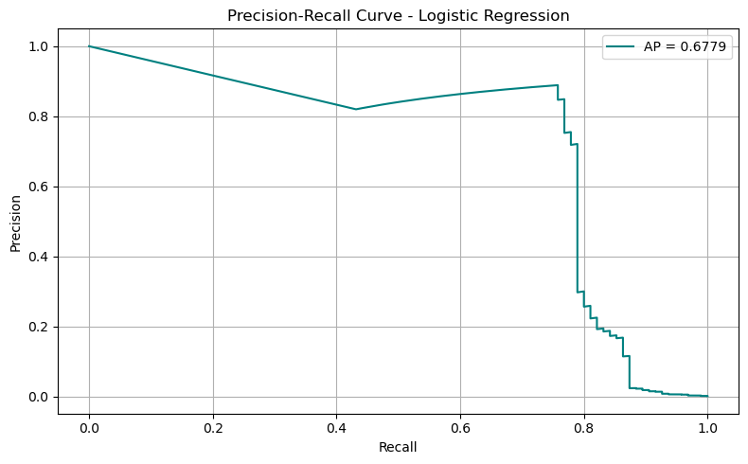
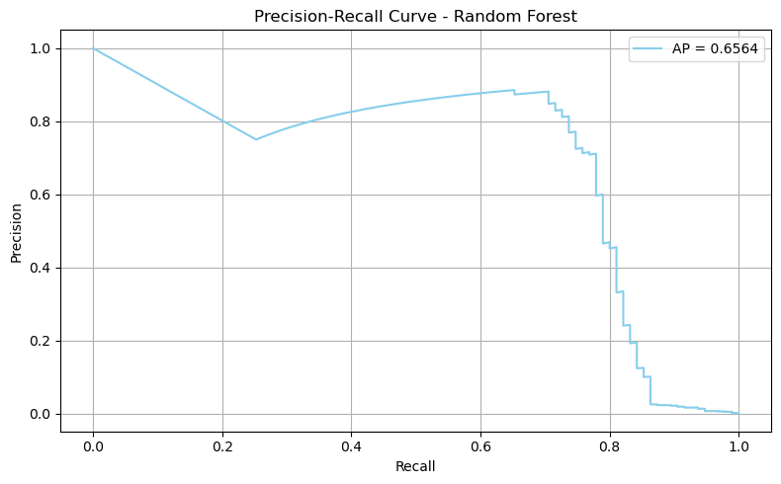
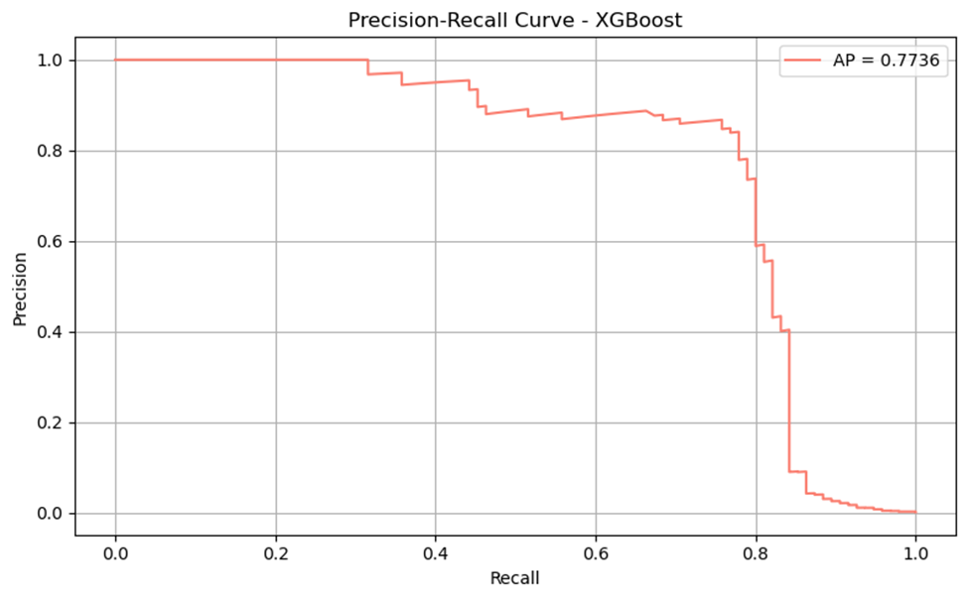
Understanding Precision Recall Curves
Notes:
This slide shows the precision recall curves for all 3 models and the average precision as recall increases. Overall, we see that XGBoost maintains consistently high precision across a wider recall range, achieving the highest AP score of 0.7736. This makes XGBoost the most stable and reliable model in terms of handling the precision-recall trade-off, which is critical in fraud detection where false positives can be costly.

Slide 12
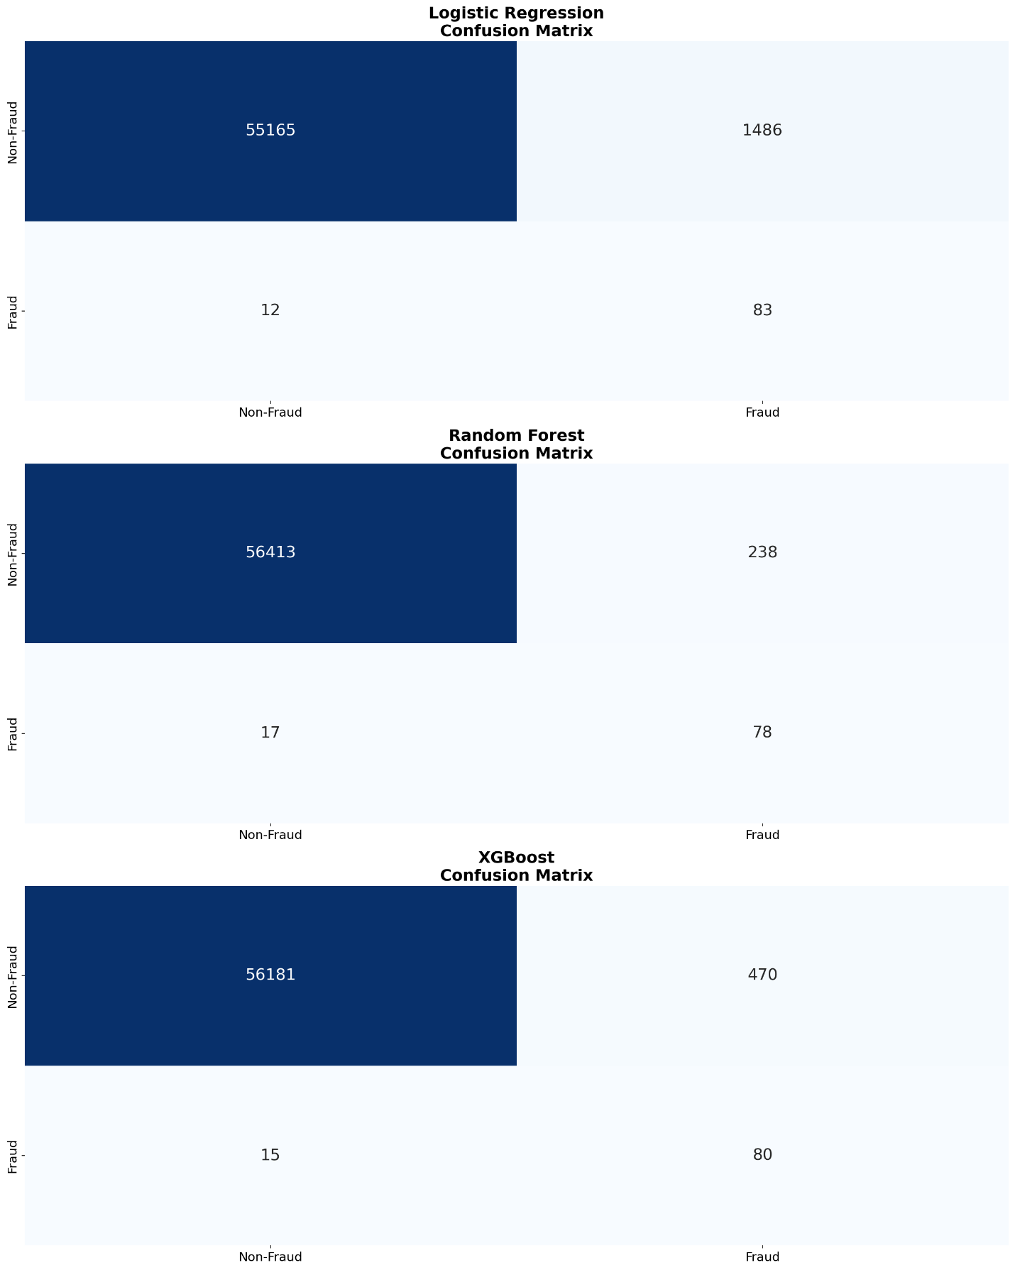
Confusion Matricies
Notes:
Finally, I created a confusion matrix for each model and testing the results.by showing each model handled fraud detection. Logistic Regression caught the most fraud but had the highest false positives. Random Forest had the best balance with fewer false alerts. XGBoost detected slightly more fraud than Random Forest but with more false positives.

Slide 13
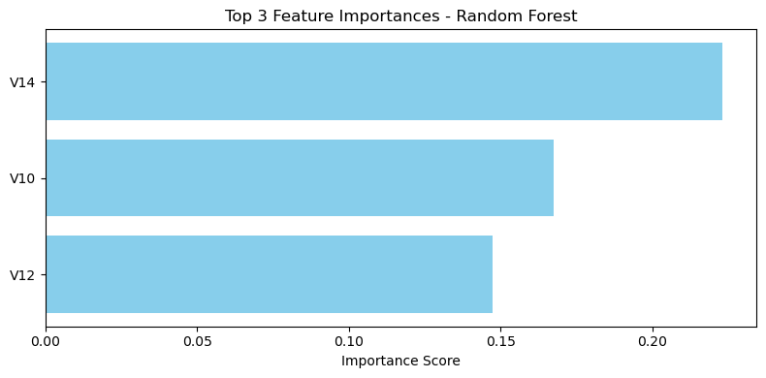
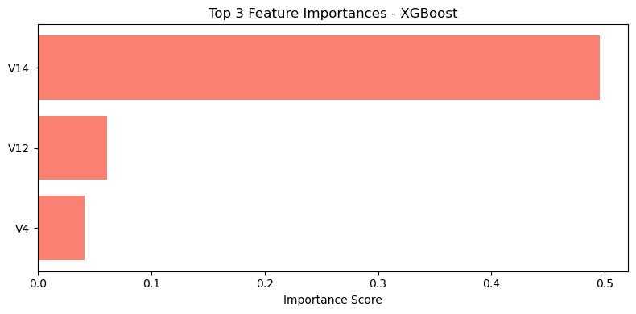
Top 3 Features
Notes:
Although the features cannot be specifically traced back to their exact variables due to PCA transformation, I decided to run a feature importance report to see if there are any significant factors within the dataset. As shown on this slide, V14 was most important across both classifier models indicating that if the dataset prior to PCA is used in future model building, there may be significant variables that trace back to fraudulent transactions

Slide 14
Conclusion
Classifier Models Perform Best
SMOTE or other oversampling/undersampling tool must be utilized to yield accurate results
V14 was the most significant feature
Notes:
Finally, as a result of model building and testing, we found that both the Random Forest Classifier and XGBoost performed best at predicting fraudulent transactions. In future analysis and deployment of this model, it is important to use some type of oversampling or undersampling tool such as SMOTE to yield accurate results. Finally, as we found from the feature importance report V14 was the most significant feature connected to fraudulent transactions and if this can be traced back in the original dataset it may provide significant importance to understanding fraudulent transactions in the future.

Slide 15
Future Recommendations
Apply models to a larger sample of the dataset over a longer period
Retrain overtime to account for changes in fraudulent activity trends
Notes:
Overall, I recommend continuing to adapt these models to larger datasets and samples over longer period of times to yield more accurate results and I also recommend retraining models' overtime to account for changes in fraudulent activity trends in the future. Thank you again for listening to this presentation, and if you have any questions, please let me know, thank you.

